Slide 1


Advanced: System optimizing mechanisms.
Will dig deeper into optimization techniques that focus on CPU management, kernel parameters, and disk allocation strategies.
Presenter
Mohammad Anees Alam
Notes:
1

Slide 2


Today's Topics
1
Intro & setup: Prometheus & Grafana.
2
Understanding data visualization tools.
3
Advanced Optimization Mechanisms.
4
Deep dive into Offloading & CPU affinity.
5
Tuning Kernel Parameters (sysctl).
6
Disk partition strategies.
Notes:
2

Slide 3


Intro: Prometheus & Grafana
SAR (System Activity Report):
  sar is a command-line tool that collects data from real-time or from historical logs like CPU, memory, disk I/O so that, it can help in monitoring the system and identify performance bottlenecks. [Ex: sar -u 1 5]
Prometheus:
  Prometheus is a monitoring tool that collects time-series data and allows you to monitor your system over weeks, months, or even years. It’s typically paired with Grafana for data visualization.
  Benefit: Prometheus can also trigger alerts when predefined conditions (like resource exhaustion) are met.
Grafana:
  Grafana is an open-source platform for monitoring and observability, primarily used for visualizing time-series data from different sources like Prometheus.
  It provides dashboards that allow you to monitor system metrics, application performance, and infrastructure health through customizable graphs, charts, and alerts.
Common commands : sar, glances.
Notes:
3

Slide 4
SAR vs GLANCES
Feature
Sar
Glances
Purpose
Long-term system activity reporting
Real-time system monitoring
Data
Historical (stored data from past hours/days)
Live, real-time stats
Metrics
CPU, memory, disk, network, etc. (historical)
CPU, memory, disk, network, load, processes, etc. (live)
Configuration
Requires setup for logging historical data
No setup needed, real-time monitoring out-of-the-box
Usage
Good for analyzing trends and performance over time
Best for immediate monitoring and troubleshooting
User interface
Text-based (command-line reports)
Interactive (text-based, but more user-friendly)
Command
sar <bottleneck_type> <Interval> <No. of reports>
glances (doesn't follow the same interval & number of reports format like sar.)
sar -u 1 5
Notes:
4

Slide 5


Follow this drive link for setup : Prometheus & Grafana setup doc
Setting up: Prometheus & Grafana.
http://localhost:9090
http://localhost:3000
Notes:
5

Slide 6

Monitoring with Prometheus & Grafana
Prometheus
Grafana
  Collects the specific time-series data for long-term monitoring.
  Visualizes data from Prometheus and other sources, creating dashboards for insights.
  Stores time-series data in its own database.
  Doesn't store data, only visualizes it from sources.
  Built-in alerting with Prometheus Alert manager.
  Can set up visual alerts on the dashboard.
  Displays metrics, logs, and application data in a readable format.
  Monitors servers, applications, or systems by scraping metrics from targets.
Notes:
6

Slide 7
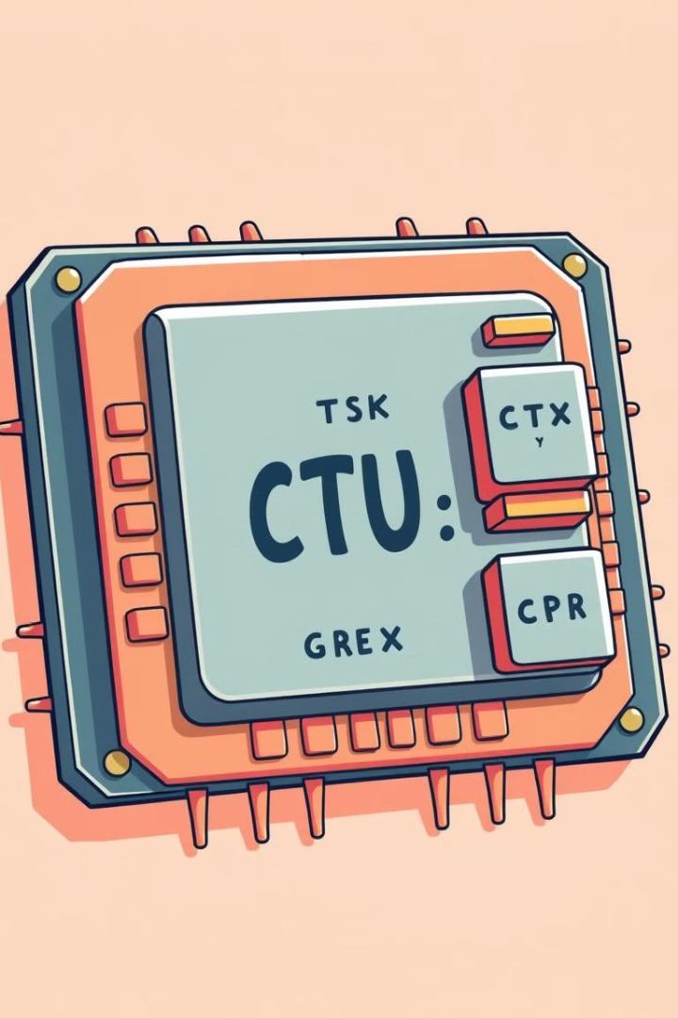
Optimizing CPU Usage
  Optimizing CPU usage is about ensuring that the system’s CPU is being used efficiently. When the CPU is overloaded, performance degrades.
  We can utilize two advanced mechanisms for it : CPU Affinity & Task Offloading.
1
CPU Affinity
2
Task Offloading
Binding processes to specific cores for improved performance and resource management.
Shifting workloads to specialized resources like GPUs or external servers to free up the CPU.
Notes:
7

Slide 8

CPU Affinity
Notes:
8

Slide 9
CPU Affinity:
CPU affinity is also known as "CPU Pinning".
This can optimize performance, as the core becomes more familiar with the process's data.
Why to use CPU Affinity and what purpose does it serve?
Performance Optimization
Preventing Overload
Real-Time Systems
  Helps in improving the execution speed.
  Allows dedicated CPU cores to each process instead of consuming power from random cores.
  Makes it easy to predict any upcoming issues with any resource conflicts.
  Command: taskset -cp 0,1 <pid> [Ex: taskset -cp 0,1 <pid_of_python_process>]
  Observations: After running the command, use top/htop to check the CPU utilization, the process should primarily run on CPU cores 0 and 1 (instead of being distributed across all cores).
Note:
  The CPU pinning is not limited to just 2 cores (0,1). It can be utilized as per the need (eg: 3,4,5).
  “taskset” command doesn’t run in mac, its only for linux distro’s.
  Can use "cpuset" but it requires few dependencies prior executing.
Notes:
9

Slide 10

Task Offloading
Notes:
10

Slide 11
Task Offloading:
The process of shifting work from one resource to another resource to improve performance or avoid overloading a specific resource.
Freeing Resources
Offloading tasks to other resources frees up the CPU for other tasks.
Performance Boost
Using dedicated resources like GPUs can significantly improve performance.
Scalability
Offloading to more powerful systems allows for scaling workloads without overloading a single system.
Used-cases:
· Offload file transfer to remote server using scp. [scp <Source> <Destination>]
· Offload file storage to AWS S3.
· Offload HTTP requests to multiple backend servers via a load balancer.
Notes:
11

Slide 12

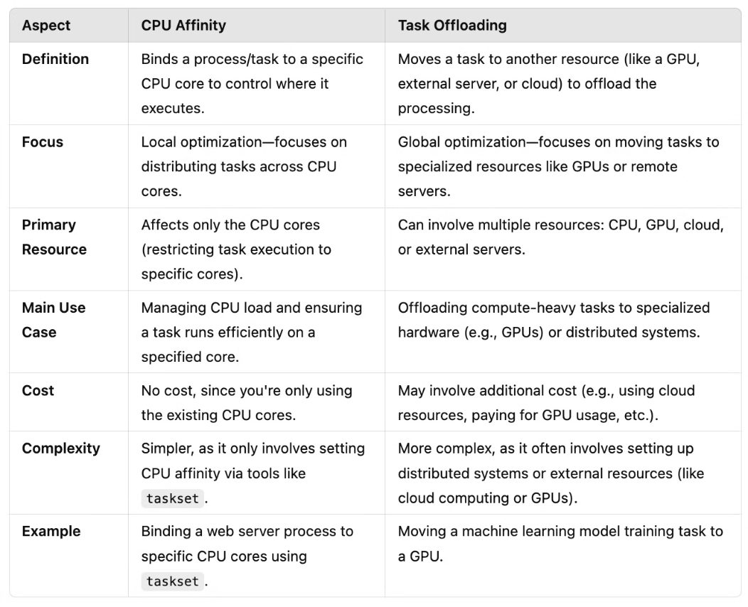
Differences: CPU Affinity & Task offloading
Notes:
12

Slide 13


Tuning Kernel Parameters
Kernel parameters control how the Linux manages resources and interacts with hardware.
Notes:
13

Slide 14
Kernel Parameters:
Kernel parameters control how the Linux kernel behaves in areas like networking, memory management, file systems, etc. These parameters are important because they determine how the system interacts with hardware and manages system resources.
Why Change Kernel Parameters?
Kernel parameters allow you to tune your system for better performance.
  You may need to adjust networking parameters if your system is handling many simultaneous connections.
  You may tweak memory settings if your system is running out of memory and using swap too often.
Real-Time Changes with sysctl:
  The sysctl command lets you change kernel parameters without rebooting.
Used cases:
  Networking parameters like net.ipv4.tcp_max_syn_backlog decide how many incoming network connections the system can handle at once.
  Memory parameters like vm.swappiness control how the system uses swap space when RAM is full.
  Note: These parameter names might differ as per the kernel versions, and these can also be disabled/renamed by configuration settings.
Notes:
14

Slide 15
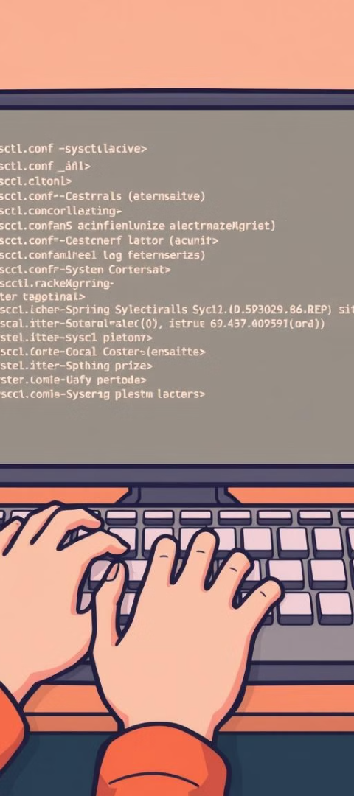
Making Changes to Kernel
Purpose
Command
Description
View Parameters
sysctl -a
To see all current kernel parameters
Modify Parameters
sysctl -w
To change specific parameters temporarily
Verify Changes
sysctl <parameter>
To check if changes were applied.
Make Persistent
Edit /etc/sysctl.conf
For permanent changes.
Apply Permanently
Use sudo sysctl -p
To reload and apply persistent changes
Notes:
15

Slide 16

Disk Partitioning Strategies
Notes:
16

Slide 17
Disk Partitioning
Read-heavy Workloads
Write-heavy Workloads
Mounting
  Tasks that need to retrieve large amounts of data quickly.
  These tasks frequently modify or add data to handle heavy writing, often used for speed and data safety.
  The process of making a disk or partition accessible to the operating system (OS) at a specific location.
  Example - SSDs are ideal because they offer faster read speeds than traditional HDDs.
  Example - Storing large amounts of data or backups in the cloud.
  Example - Local disk (C)
Notes:
17

Slide 18





Disk Partitioning commands
View Partitions
Create Partition
  Use lsblk to list all disks and partitions.
Use sudo fdisk to create new partitions.
  Might not be available by default so use "sudo apt/yum install util-linux"
  For Mac: diskutil list
Mount Partition
Check Mounts
Use sudo mount to make a partition accessible.
Use df -h to verify that a partition is mounted correctly.
Notes:
18

Slide 19

Conclusion
  Prometheus collects and stores the metrics, Grafana visualizes those metrics in an easy-to-read dashboard for better operational insights.
  CPU Affinity: Best when you want to optimize local resources (CPU cores) on a single machine without external dependencies. Task Offloading: Best when the task demands specialized resources (e.g., GPU, cloud) or when you want to offload workloads to distributed systems to scale.
  Kernel parameters control the system behavior for networking, memory management, and other resource allocation tasks. The sysctl command allows you to modify these parameters in real-time without needing to reboot. Changes can be applied temporarily or made persistent by modifying system configuration files.
  Partitioning is useful for optimizing disk performance for read-heavy or write-heavy tasks. The fdisk and mount commands help in creating partitions and making them accessible.
Notes:
19

